Slide 1
Airline Survey

Slide 2
Airline Survey
Agenda:
Analyze airline passenger satisfaction using machine learning techniques.
Primary goal:
To predict customer satisfaction based on factors such as age, type of travel, flight distance, seat comfort, and more.
Why?
Customer satisfaction is crucial in the airline industry for improving services, retaining customers, and enhancing overall experiences. By exploring the key drivers behind satisfaction, we can offer insights to help airlines make data-driven decisions for service improvements.

Slide 3
What do we Achieve ?
Predict how satisfied a passenger is based on their feedback on specific services.
Objective: Predict the level of satisfaction a passenger will have based on their ratings for services like Seat comfort, Food and drink, In-flight Wifi, Baggage handling, etc.
Method: This could be approached as a regression problem if satisfaction is treated as a continuous variable (e.g., converting it to a numeric scale) or as a classification problem for binary satisfaction levels (e.g., satisfied vs not satisfied).
What are the key areas of improvement for airlines to boost passenger satisfaction?
Objective: Use the data to identify which service areas (e.g., Food and drink, In-flight entertainment, Cleanliness, etc.) correlate most with lower satisfaction scores, and provide actionable insights for improvement.
Method: Analyze the ratings and look for service areas that frequently receive low scores and have a strong correlation with low satisfaction ratings.
How does satisfaction vary across different demographic groups?
Objective: Determine whether factors like age, gender, or customer type (First-time vs Returning customers) result in different satisfaction levels.
Method: Perform demographic analysis using grouping and visualization techniques like histograms or box plots to show variations in satisfaction across different demographics.
Segment passengers into different clusters based on their travel behavior and service feedback.
Objective: Identify distinct passenger groups based on their feedback (e.g., business travelers vs. personal travelers, high-rating passengers vs. low-rating passengers).
Method: Use clustering algorithms such as K-Means or Hierarchical Clustering to discover segments of passengers with similar behavior or service preferences.

Slide 4
Airline Survey
Dataset 1
ID | Gender | Age | Customer Type | Type of Travel | Class | Flight Distance | Departure Delay | Arrival Delay | Departure and Arrival Time Convenience | Ease of Online Booking | Check-in Service | Online Boarding | Gate Location | On-board Service | Seat Comfort | Leg Room Service | Cleanliness | Food and Drink | In-flight Service | In-flight Wifi Service | In-flight Entertainment | Baggage Handling | Satisfaction
1 | Male | 48 | First-time | Business | Business | 821 | 2 | 5 | 3 | 3 | 4 | 3 | 3 | 3 | 5 | 2 | 5 | 5 | 5 | 3 | 5 | 5 | Neutral or Dissatisfied
2 | Female | 35 | Returning | Business | Business | 821 | 26 | 39 | 2 | 2 | 3 | 5 | 2 | 5 | 4 | 5 | 5 | 3 | 5 | 2 | 5 | 5 | Satisfied
3 | Male | 41 | Returning | Business | Business | 853 | 0 | 0 | 4 | 4 | 4 | 5 | 4 | 3 | 5 | 3 | 5 | 5 | 3 | 4 | 3 | 3 | Satisfied
4 | Male | 50 | Returning | Business | Business | 1905 | 0 | 0 | 2 | 2 | 3 | 4 | 2 | 5 | 5 | 5 | 4 | 4 | 5 | 2 | 5 | 5 | Satisfied
5 | Female | 49 | Returning | Business | Business | 3470 | 0 | 1 | 3 | 3 | 3 | 5 | 3 | 3 | 4 | 4 | 5 | 4 | 3 | 3 | 3 | 3 | Satisfied
6 | Male | 43 | Returning | Business | Business | 3788 | 0 | 0 | 4 | 4 | 3 | 5 | 4 | 4 | 4 | 4 | 3 | 3 | 4 | 4 | 4 | 4 | Satisfied
7 | Male | 43 | Returning | Business | Business | 1963 | 0 | 0 | 3 | 3 | 4 | 4 | 3 | 5 | 5 | 5 | 4 | 5 | 5 | 3 | 5 | 5 | Satisfied
Source: https://www.kaggle.com/datasets/mysarahmadbhat/airline-passenger-satisfaction/data

Slide 5
Airline Survey
Dataset 1 - Details
Field | Description | Feature/Class | Data type | Observation
ID | Unique passenger identifier | NA | int64 | To be excluded
Gender | Gender of the passenger (Female/Male) | Feature | object | No Null Value Valid values are Femal/Male
Age | Age of the passenger | Feature | int64 | Age between 7 & 84 Distributiion peaks around 20-60 No Null Values
Customer Type | Type of airline customer (First-time/Returning) | Feature | object | No Null values Distribution is more around Returning
Type of Travel | Purpose of the flight (Business/Personal) | Feature | object | No Null values but values are more towards Business Passengers
Class | Travel class in the airplane for the passenger seat | Feature | object | No Null values but values are more towards Business Passengers
Flight Distance | Flight distance in miles | Feature | int64 | No Null values
Departure Delay | Flight departure delay in minutes | Feature | int64 | No Null values
Arrival Delay | Flight arrival delay in minutes | Feature | float64 | Null values are identified. Mean value will be taken up
Departure and Arrival Time Convenience | Satisfaction level with the convenience of the flight departure and arrival times from 1 (lowest) to 5 (highest) - 0 means "not applicable" | Feature | int64 | No Null values
Ease of Online Booking | Satisfaction level with the online booking experience from 1 (lowest) to 5 (highest) - 0 means "not applicable" | Feature | int64 | No Null values
Check-in Service | Satisfaction level with the check-in service from 1 (lowest) to 5 (highest) - 0 means "not applicable" | Feature | int64 | No Null values
Online Boarding | Satisfaction level with the online boarding experience from 1 (lowest) to 5 (highest) - 0 means "not applicable" | Feature | int64 | No Null values
Gate Location | Satisfaction level with the gate location in the airport from 1 (lowest) to 5 (highest) - 0 means "not applicable" | Feature | int64 | No Null values
On-board Service | Satisfaction level with the on-boarding service in the airport from 1 (lowest) to 5 (highest) - 0 means "not applicable" | Feature | int64 | No Null values
Seat Comfort | Satisfaction level with the comfort of the airplane seat from 1 (lowest) to 5 (highest) - 0 means "not applicable" | Feature | int64 | No Null values
Leg Room Service | Satisfaction level with the leg room of the airplane seat from 1 (lowest) to 5 (highest) - 0 means "not applicable" | Feature | int64 | No Null values
Cleanliness | Satisfaction level with the cleanliness of the airplane from 1 (lowest) to 5 (highest) - 0 means "not applicable" | Feature | int64 | No Null values
Food and Drink | Satisfaction level with the food and drinks on the airplane from 1 (lowest) to 5 (highest) - 0 means "not applicable" | Feature | int64 | No Null values
In-flight Service | Satisfaction level with the in-flight service from 1 (lowest) to 5 (highest) - 0 means "not applicable" | Feature | int64 | No Null values
In-flight Wifi Service | Satisfaction level with the in-flight Wifi service from 1 (lowest) to 5 (highest) - 0 means "not applicable" | Feature | int64 | No Null values
In-flight Entertainment | Satisfaction level with the in-flight entertainment from 1 (lowest) to 5 (highest) - 0 means "not applicable" | Feature | int64 | No Null values
Baggage Handling | Satisfaction level with the baggage handling from the airline from 1 (lowest) to 5 (highest) - 0 means "not applicable" | Feature | int64 | No Null values
Satisfaction | Overall satisfaction level with the airline (Satisfied/Neutral or unsatisfied) | Class | object | No Null values To be converted to 0 & 1

Slide 6
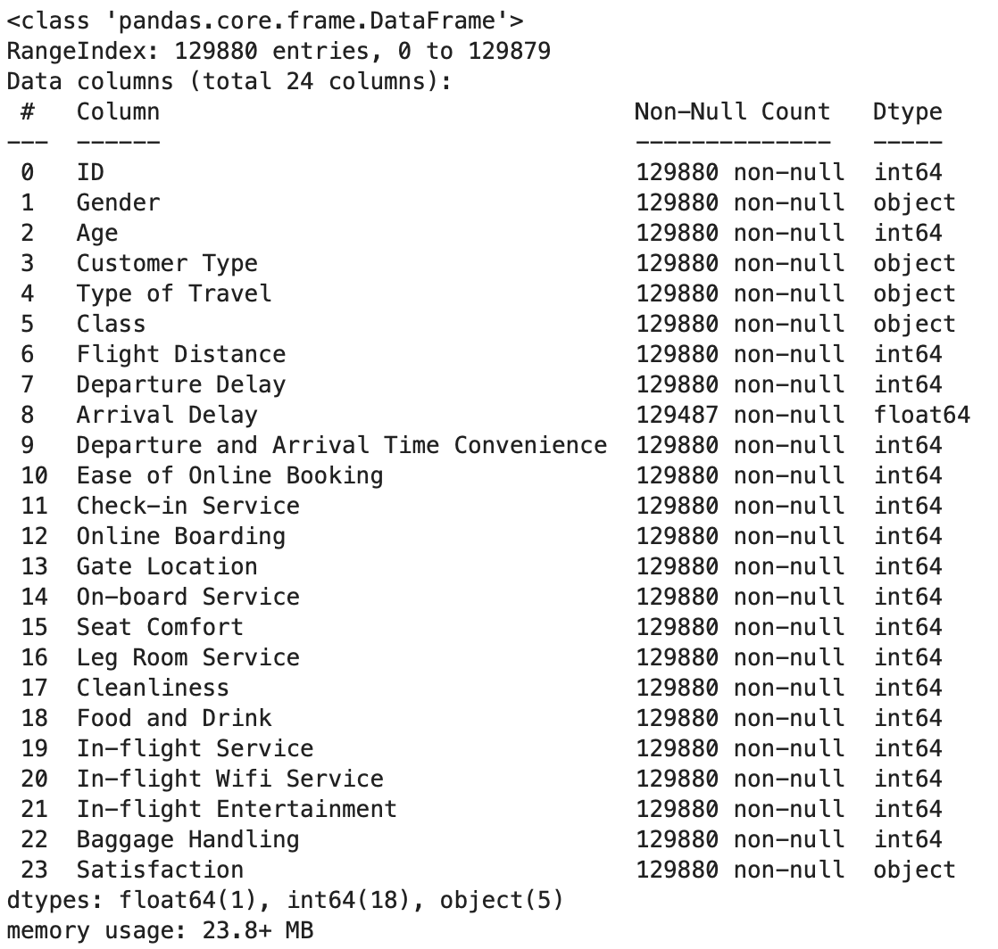
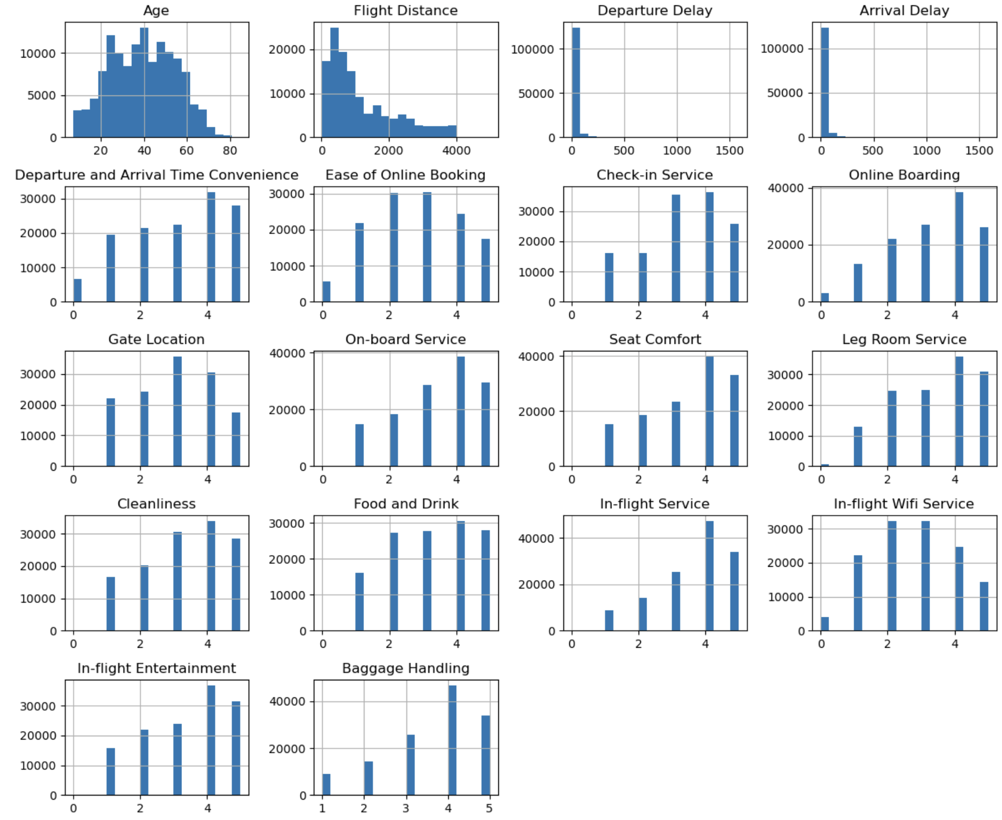
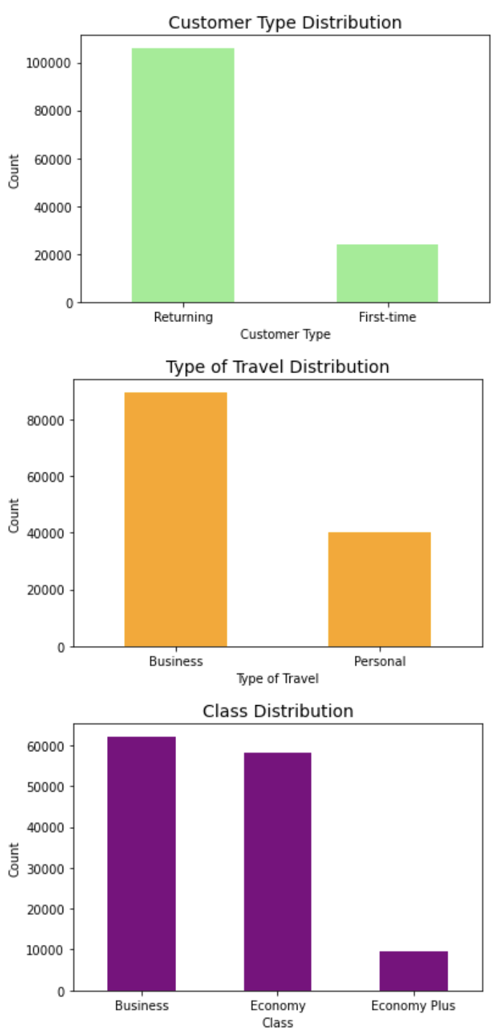
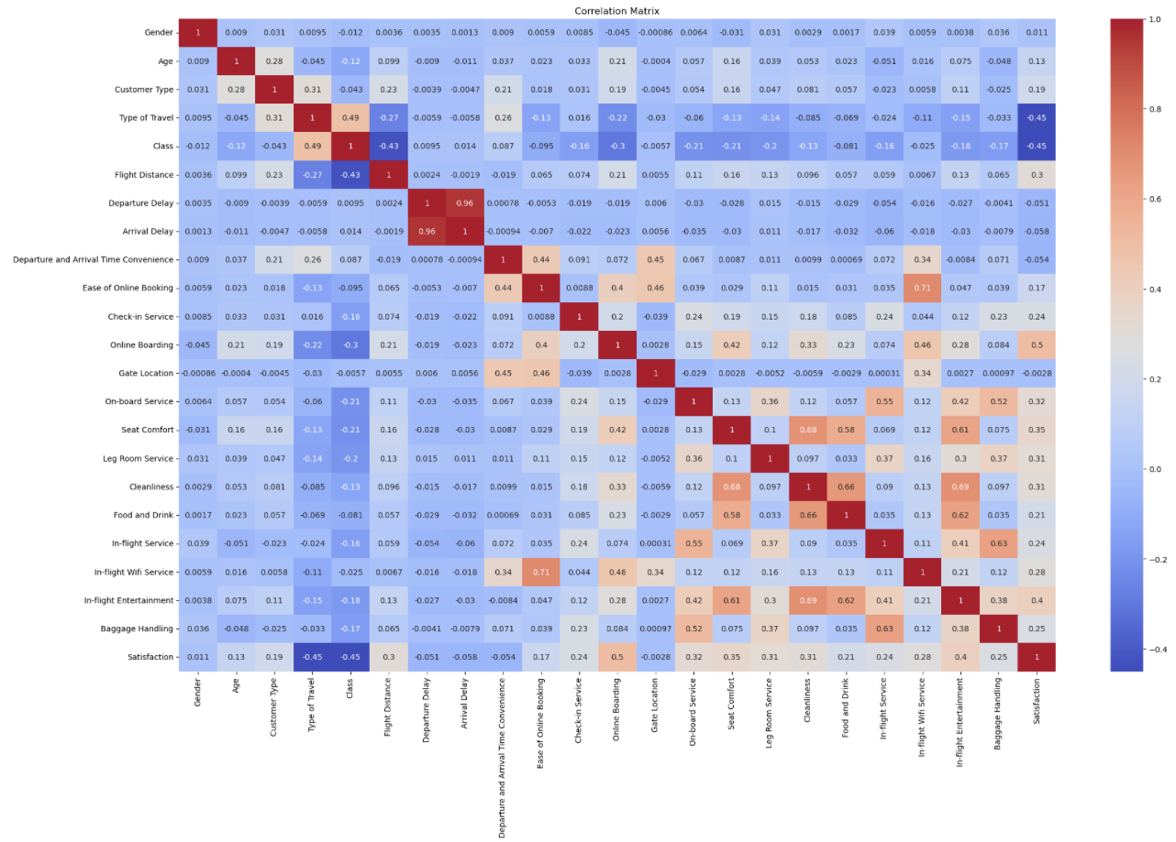
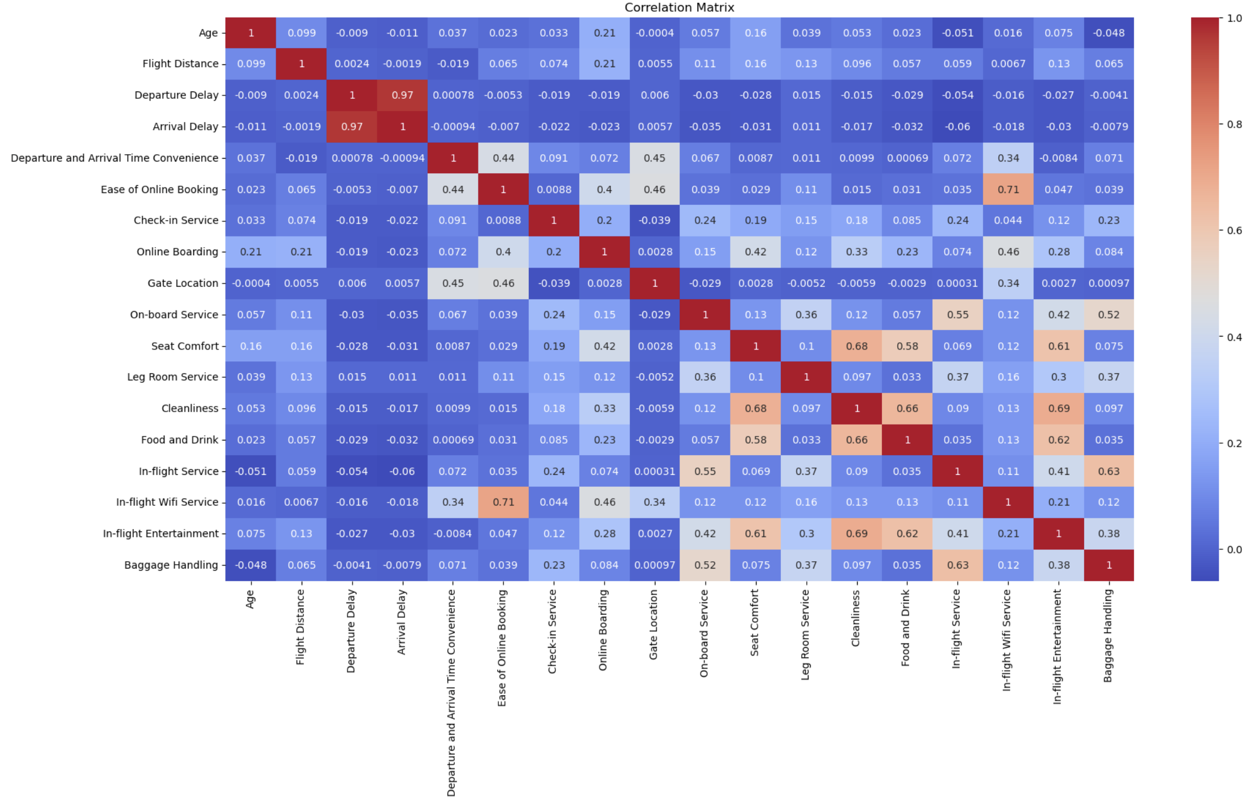
Airline Survey
Dataset 1 - Plot

Slide 7
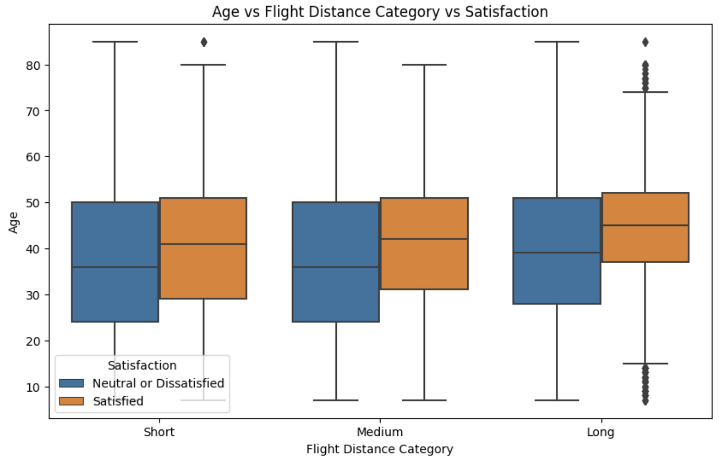
Airline Survey
Dataset 1 - Segmentation

Slide 8
Airline Survey
Dataset 2
 | id | Gender | Customer Type | Age | Type of Travel | Class | Flight Distance | Inflight wifi service | Departure/Arrival time convenient | Ease of Online booking | Gate location | Food and drink | Online boarding | Seat comfort | Inflight entertainment | On-board service | Leg room service | Baggage handling | Checkin service | Inflight service | Cleanliness | Departure Delay in Minutes | Arrival Delay in Minutes | satisfaction
0 | 70172 | Male | Loyal Customer | 13 | Personal Travel | Eco Plus | 460 | 3 | 4 | 3 | 1 | 5 | 3 | 5 | 5 | 4 | 3 | 4 | 4 | 5 | 5 | 25 | 18 | neutral or dissatisfied
1 | 5047 | Male | disloyal Customer | 25 | Business travel | Business | 235 | 3 | 2 | 3 | 3 | 1 | 3 | 1 | 1 | 1 | 5 | 3 | 1 | 4 | 1 | 1 | 6 | neutral or dissatisfied
2 | 110028 | Female | Loyal Customer | 26 | Business travel | Business | 1142 | 2 | 2 | 2 | 2 | 5 | 5 | 5 | 5 | 4 | 3 | 4 | 4 | 4 | 5 | 0 | 0 | satisfied
3 | 24026 | Female | Loyal Customer | 25 | Business travel | Business | 562 | 2 | 5 | 5 | 5 | 2 | 2 | 2 | 2 | 2 | 5 | 3 | 1 | 4 | 2 | 11 | 9 | neutral or dissatisfied
4 | 119299 | Male | Loyal Customer | 61 | Business travel | Business | 214 | 3 | 3 | 3 | 3 | 4 | 5 | 5 | 3 | 3 | 4 | 4 | 3 | 3 | 3 | 0 | 0 | satisfied
5 | 111157 | Female | Loyal Customer | 26 | Personal Travel | Eco | 1180 | 3 | 4 | 2 | 1 | 1 | 2 | 1 | 1 | 3 | 4 | 4 | 4 | 4 | 1 | 0 | 0 | neutral or dissatisfied
6 | 82113 | Male | Loyal Customer | 47 | Personal Travel | Eco | 1276 | 2 | 4 | 2 | 3 | 2 | 2 | 2 | 2 | 3 | 3 | 4 | 3 | 5 | 2 | 9 | 23 | neutral or dissatisfied
7 | 96462 | Female | Loyal Customer | 52 | Business travel | Business | 2035 | 4 | 3 | 4 | 4 | 5 | 5 | 5 | 5 | 5 | 5 | 5 | 4 | 5 | 4 | 4 | 0 | satisfied
Source: https://www.kaggle.com/datasets/teejmahal20/airline-passenger-satisfaction/data

Slide 9
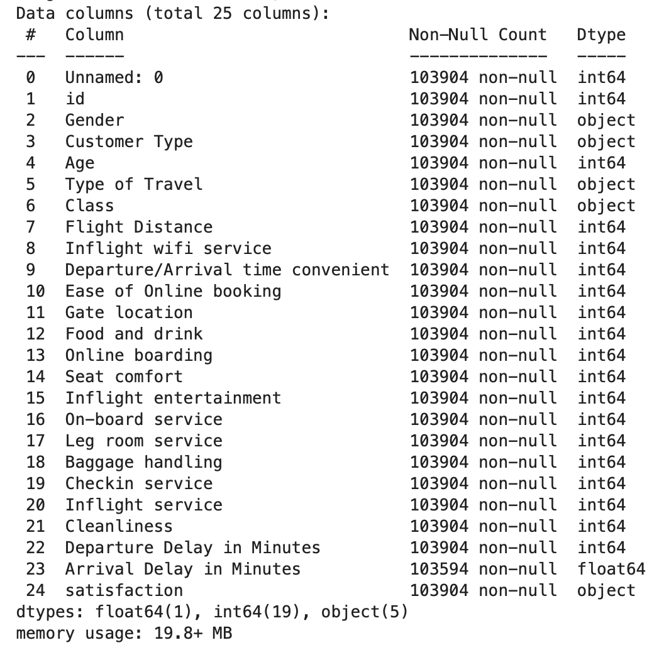
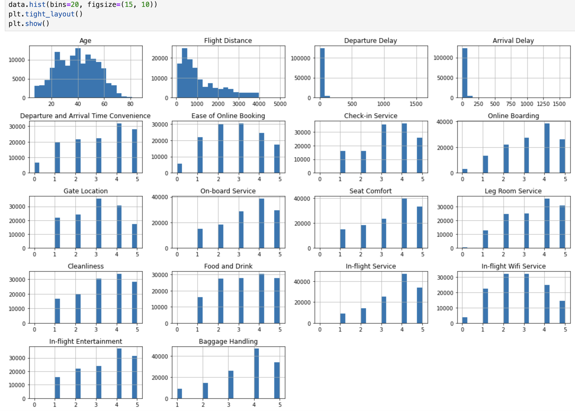
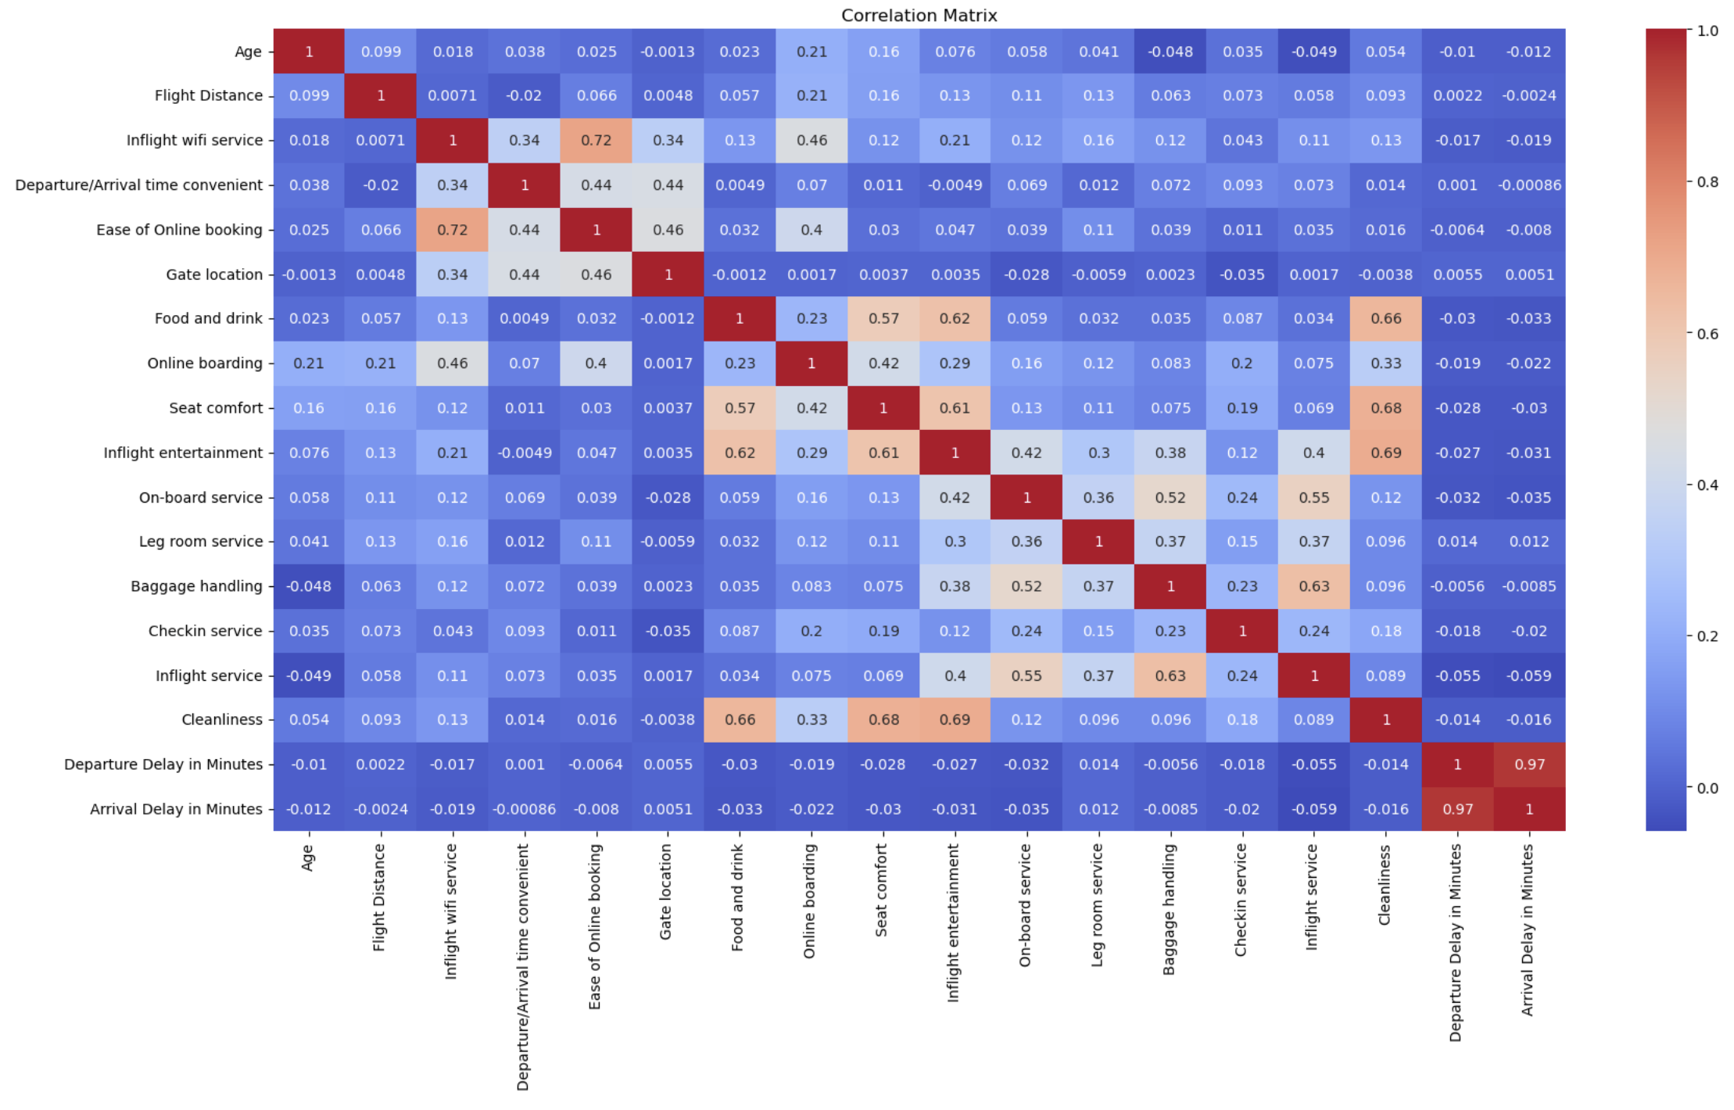
Airline Survey
Dataset 2 - Details

Slide 10
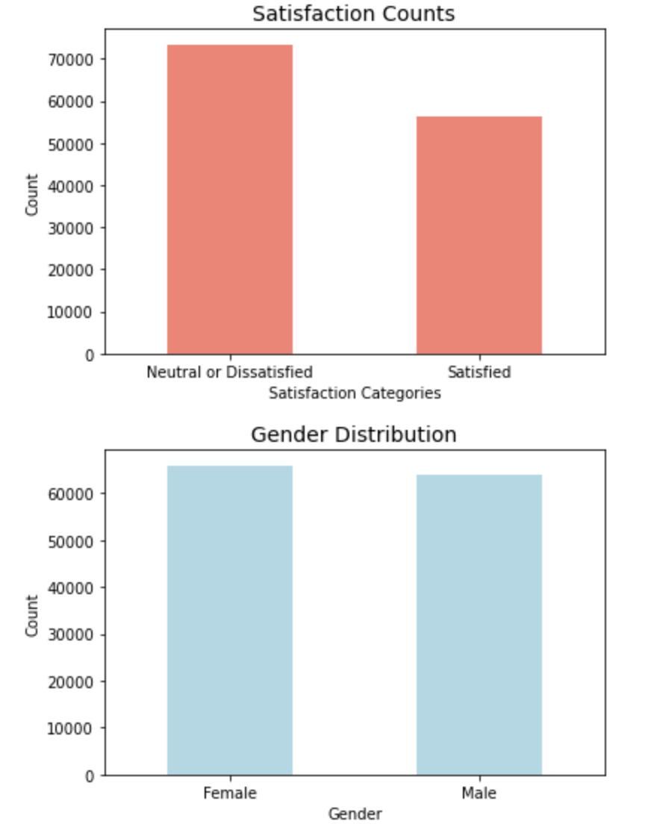
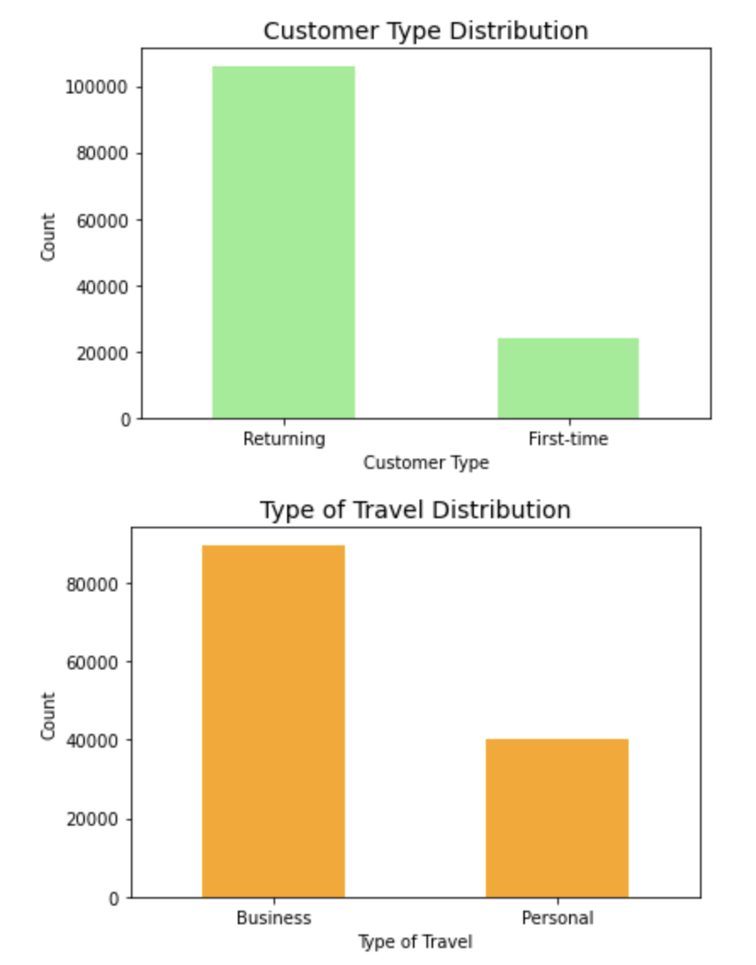
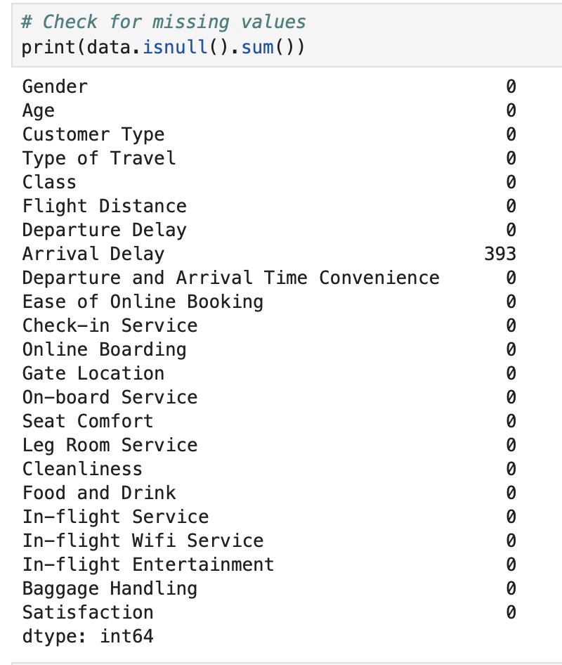
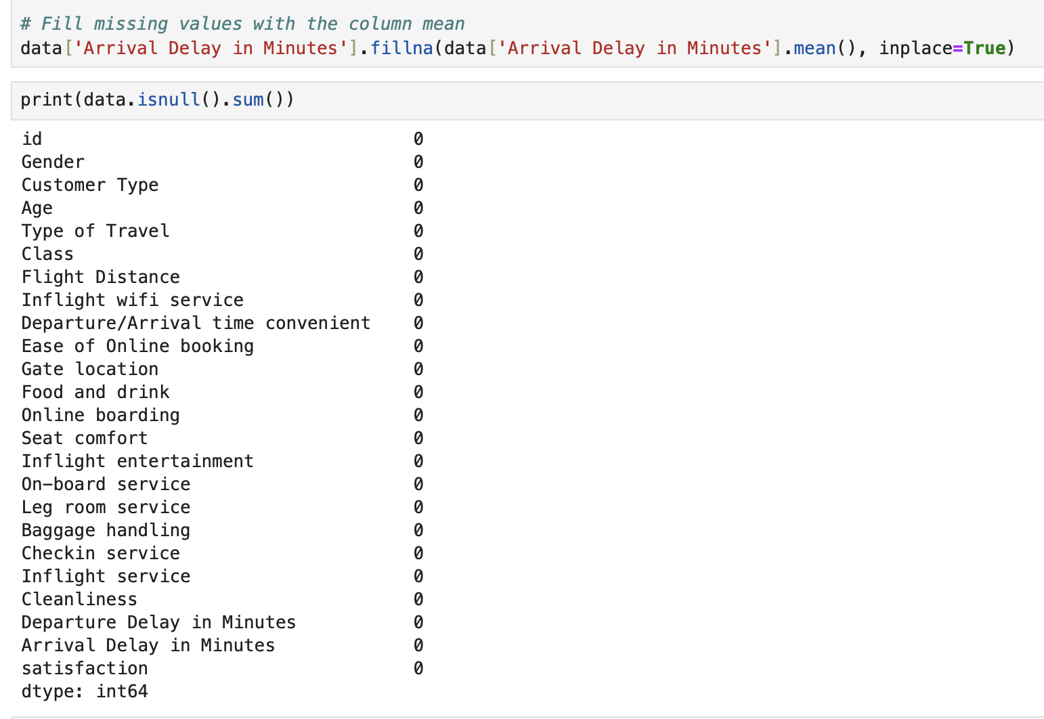
Airline Survey
Dataset 2 - Details

Slide 11




Airline Survey
Dataset 3 - Image
Source: https://www.kaggle.com/datasets/hearfool/vggface2/data

Slide 12
Project Timelines
R1
R2
R3
R4
R5
Project Direction and Questions
Data Analysis and Preprocessing
Clustering
Baseline Training and Evaluation
Neural Networks
Define clear objectives and hypotheses (e.g., key factors influencing satisfaction).
Complete initial exploratory data analysis and problem identification.
Perform data cleaning, handling missing values, and transformation of features.
Visualize relationships and identify important patterns
Use clustering algorithms (e.g., K-Means) to segment passengers based on similar characteristics and satisfaction levels.
Evaluate clustering results using silhouette scores.
Train three machine learning models: Decision Tree, K-Nearest Neighbors (KNN), and Naive Bayes for classification.
Evaluate models using accuracy, precision, recall, and F1-score.
Implement Multi-Layer Perceptron (MLP) for satisfaction prediction.
Fine-tune the model and compare its performance with the baseline models
Project Finalization & Report
Week 1 & 2
Week 3 & 4
Week 4 & 5
Week 6 & 7
Week 8 & 9

Slide 13
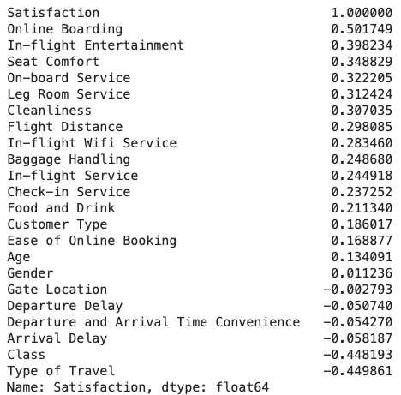
Airline Survey
Dataset 1 - Segmentation

Slide 14
Airline Survey
Dataset 1 - Plot

